Slide 1
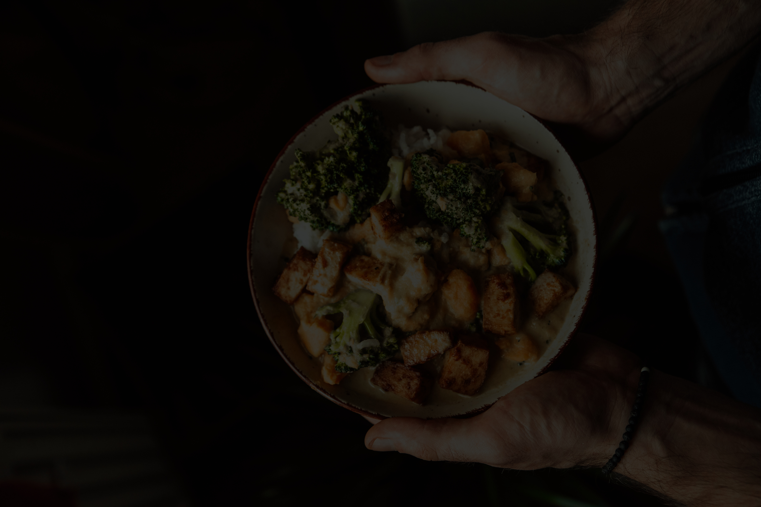



KULINARASA
Search
KULINARASA
PROYEK AKHIR SISTEM BASIS DATA
BY KELOMPOK 8
Get Started

Slide 2
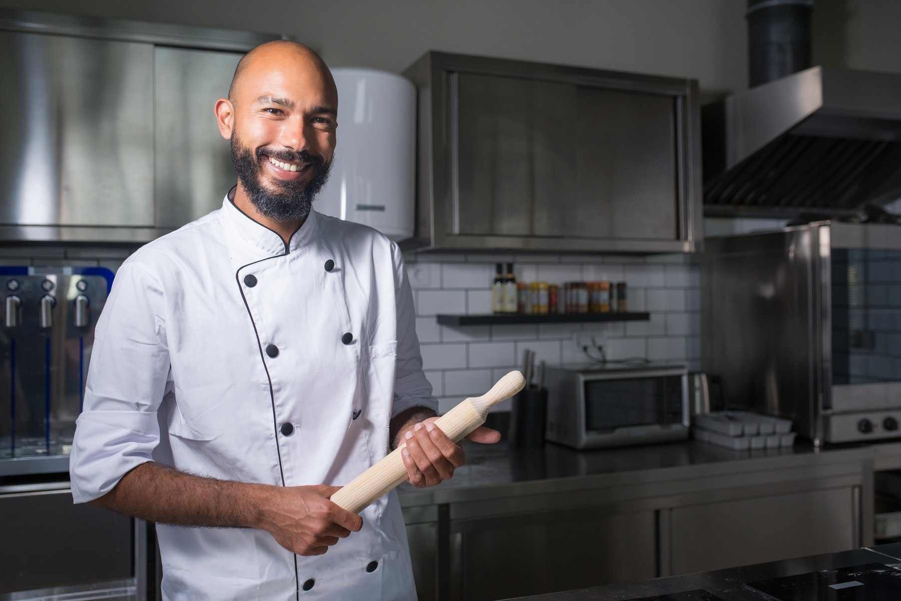
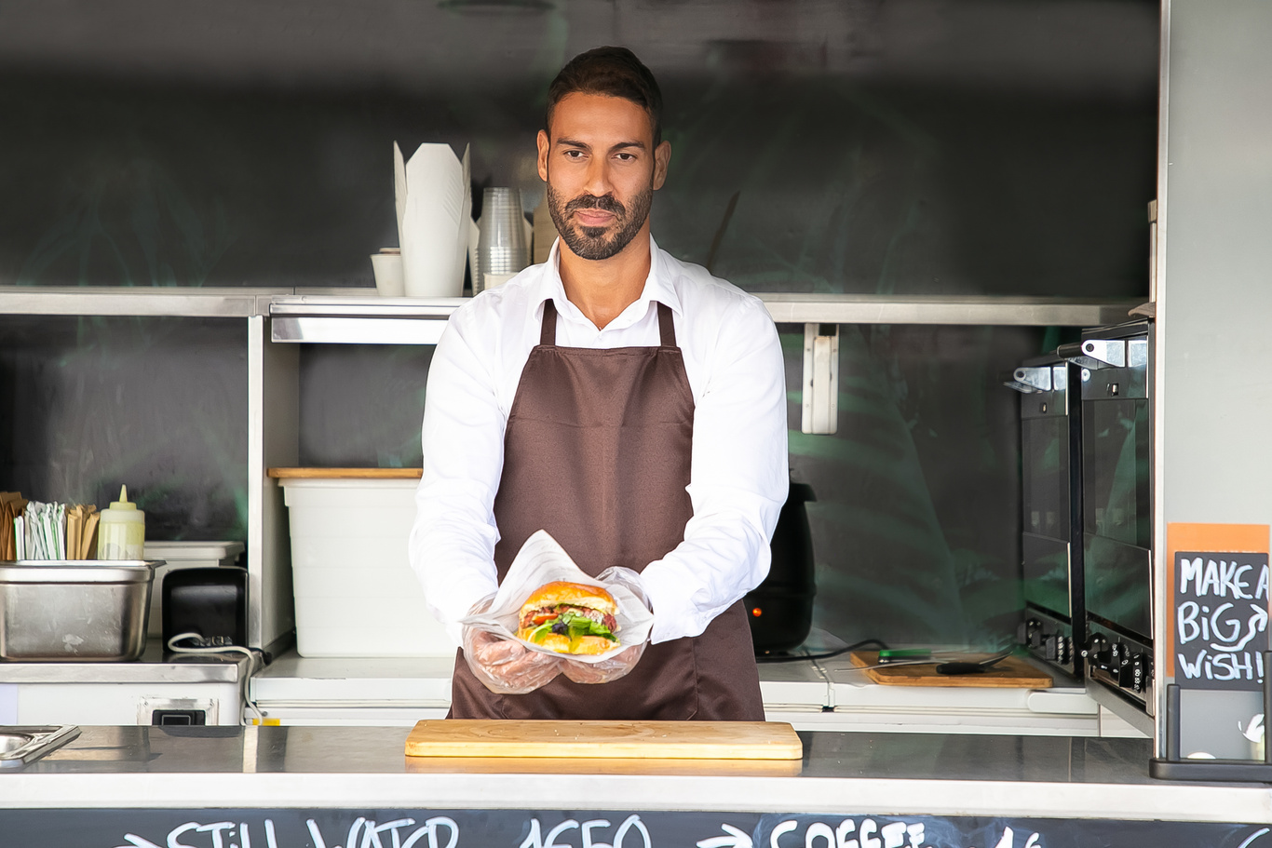
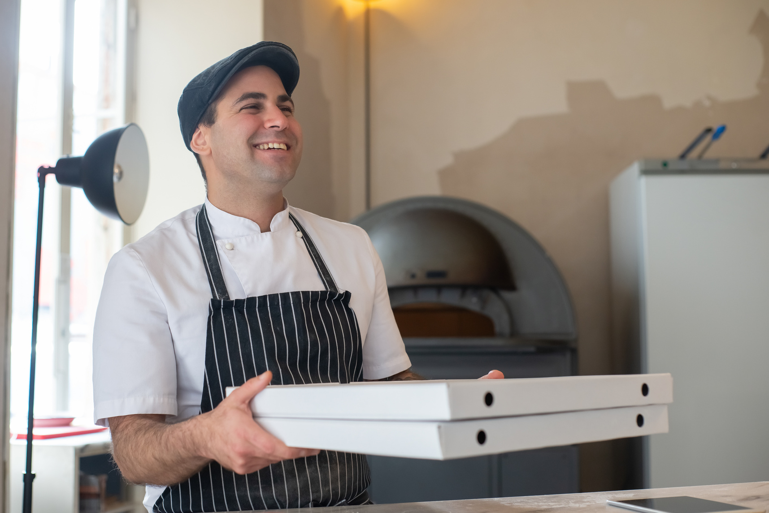

KULINARASA
Search
Meet Our Team
people who make this happened.
Maharaka Fadhilah
Syahmi Hamdani
Anthonius Hendhy Wirawan
Muhammad Rifat Faqih

Slide 3
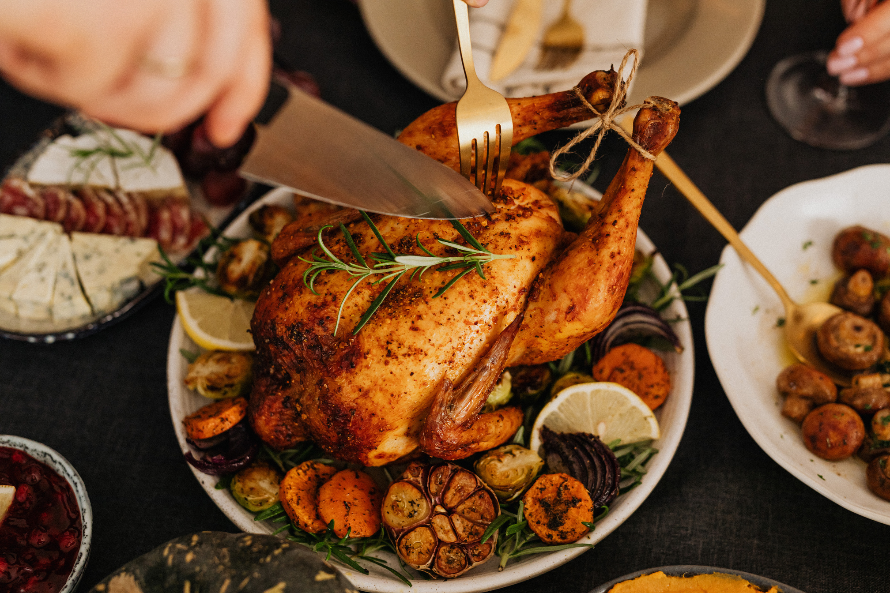
KULINARASA
Search
WHAT is
KULINARASA?
we are an interactive digital platform designed to preserve, document, and share traditional Indonesian recipes. By combining visually engaging content with a comprehensive data-driven management system, Kulinarasa aims to celebrate Indonesia's rich culinary heritage and make it accessible to a broader audience.
Learn More

Slide 4
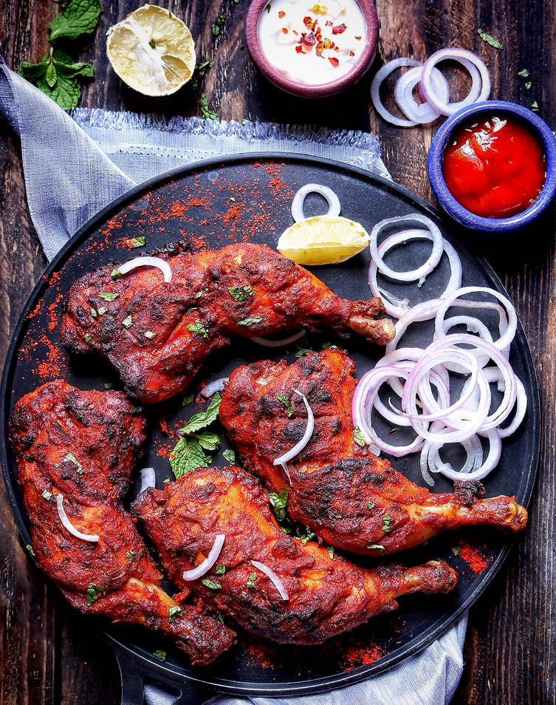
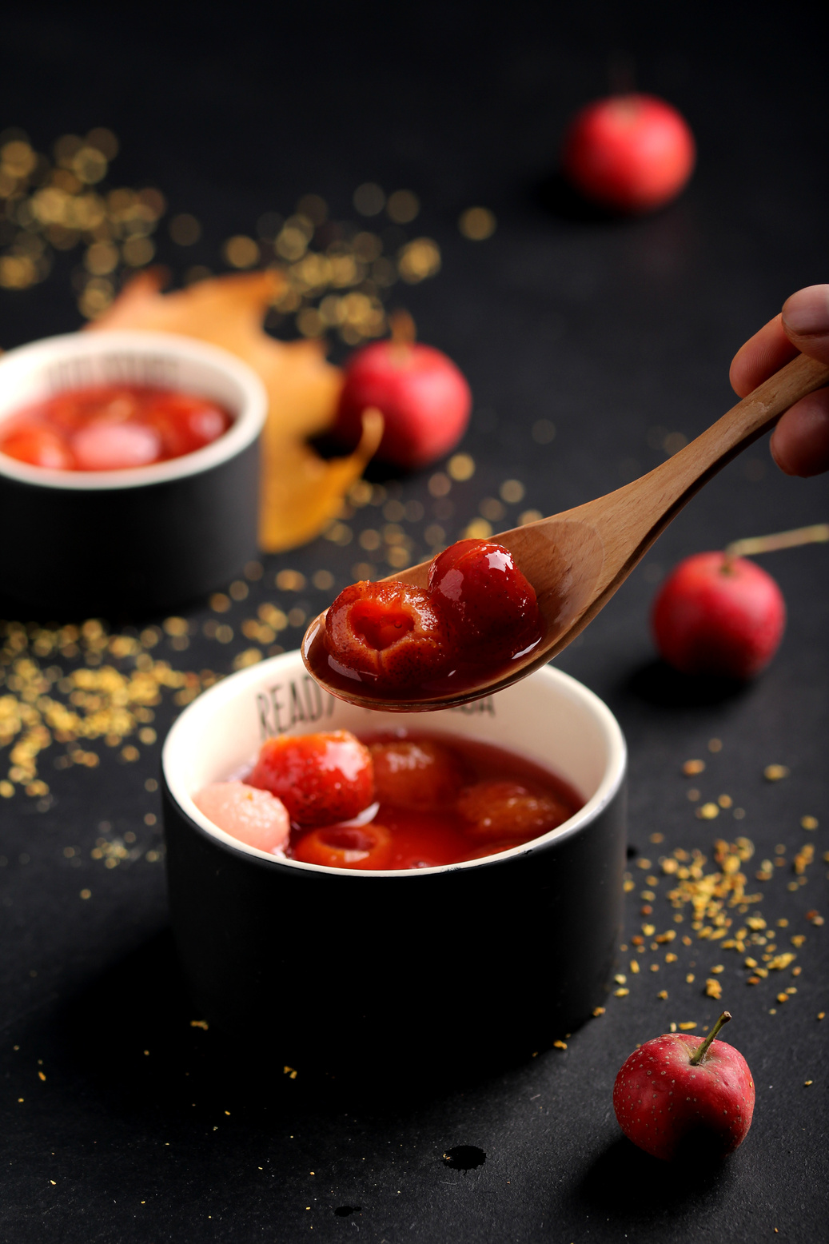
KULINARASA
Search
WHY CHOOSE
KULINARASA?
Authentic Recipes
Visual Presentation
Data-Driven Management
Community Contributions
Private & Public Recipes
Learn More

Slide 5
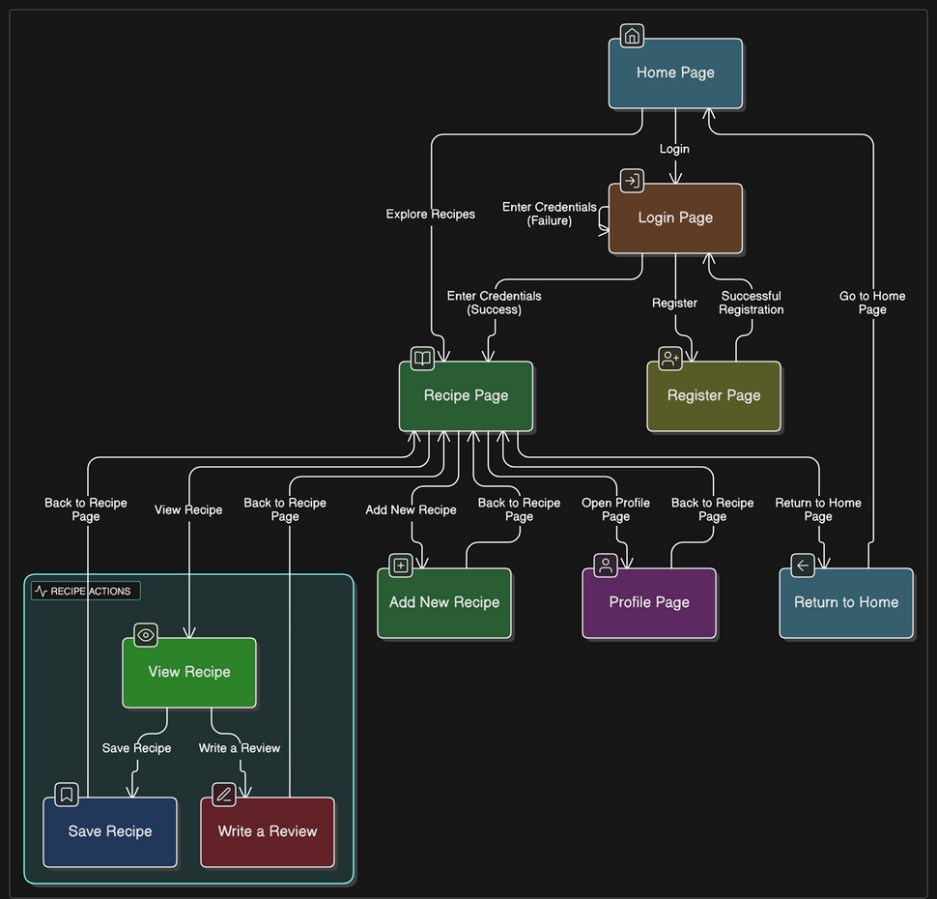


KULINARASA
Search
App Flowchart
a visual diagram that maps out the structure and navigation of our website. Illustrates how users can move from one page to another

Slide 6
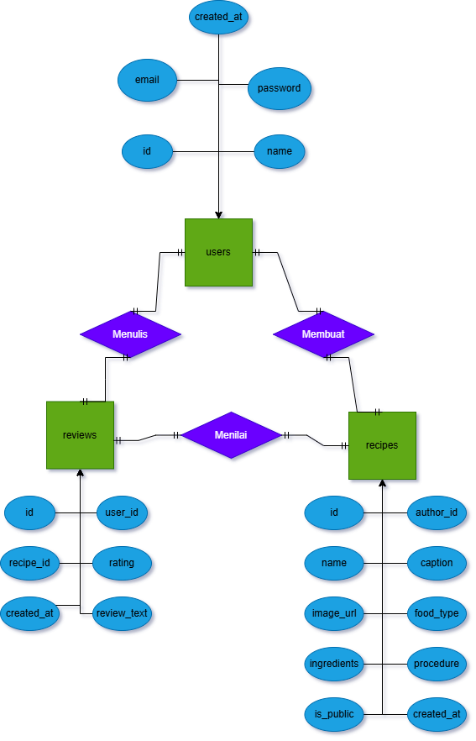
KULINARASA
Search
UML DIAGRAM
this diagrams show how objects interact over time, visualizing the order of messages exchanged between objects in our app
Learn More

Slide 7
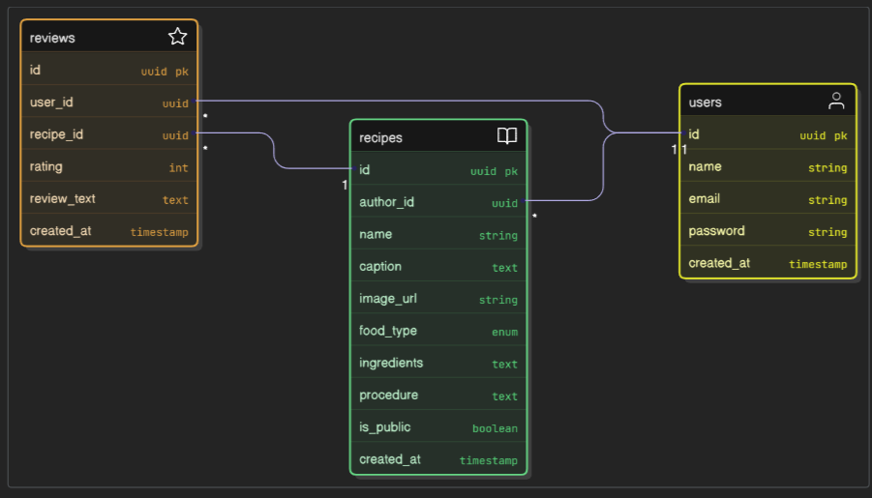
KULINARASA
Search
ERD
this is a visual representation of how data is organized and related within a database in our app
Learn More

Slide 8
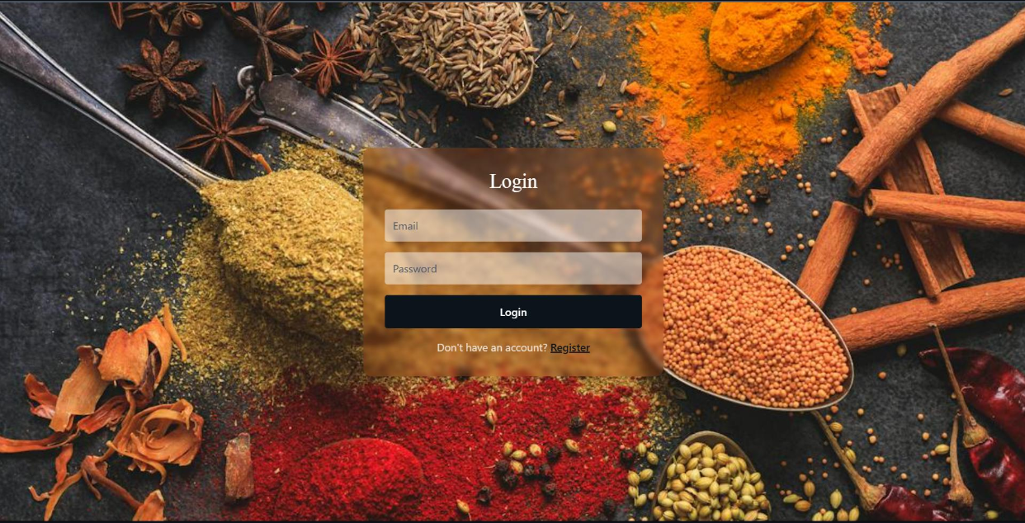
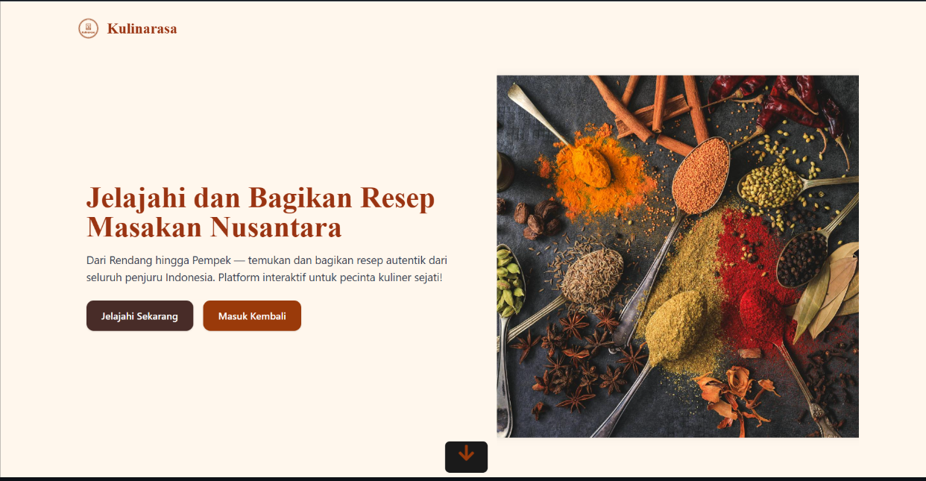
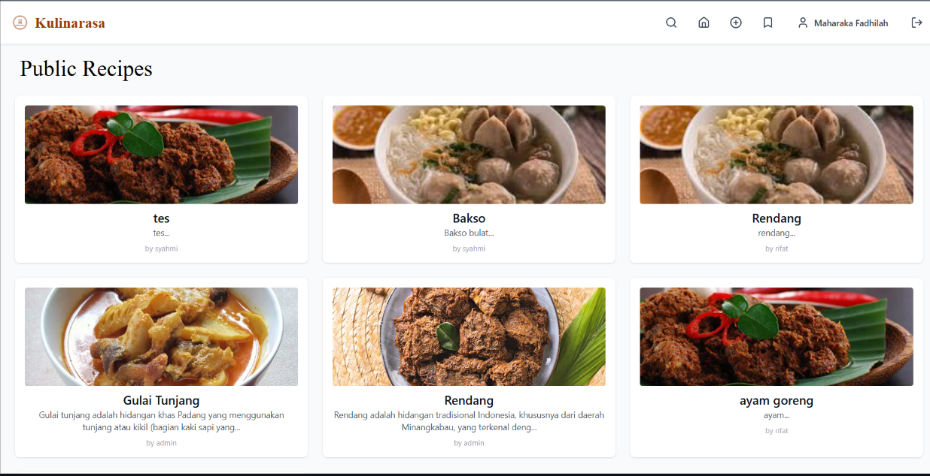
KULINARASA
Search
Web Overview
these are what our website user interface

Slide 9

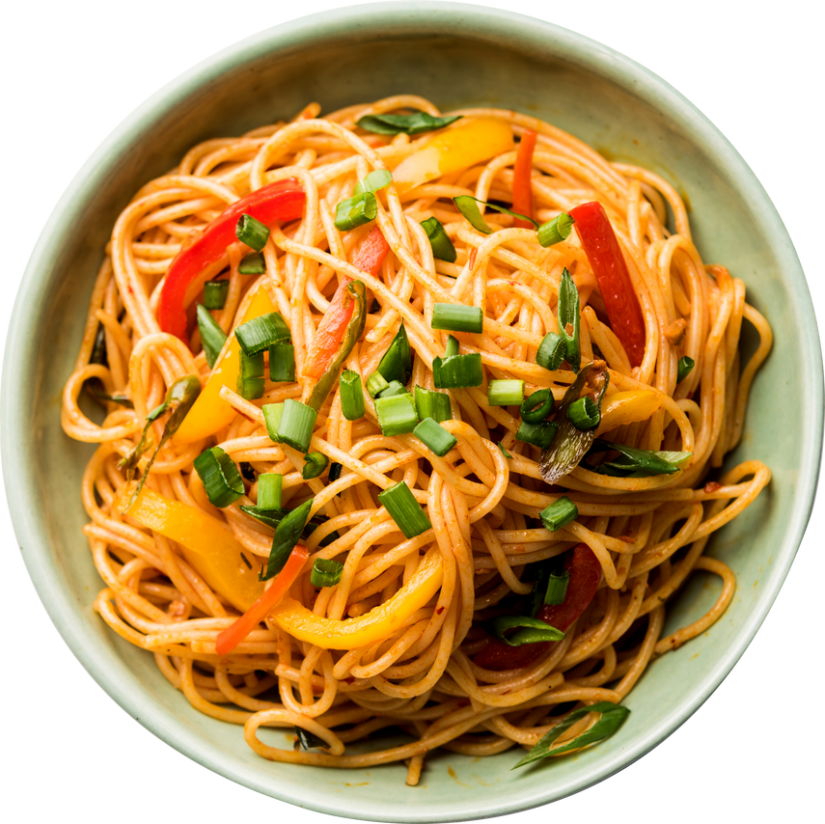
KULINARASA
Search
Thank You
ANY QUESTIONS OR RESPONSES?

